Slide 1
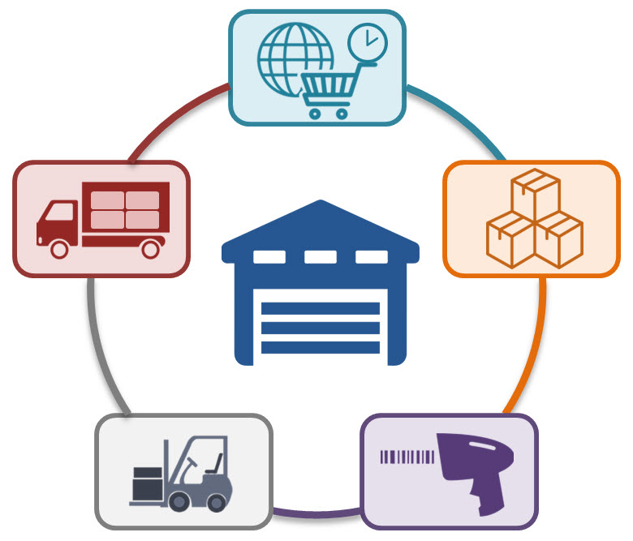
WAREHOUSE MANAGEMENT SYSTEM
A warehouse management system (WMS) is a software application that helps control and manage the day-to-day operations in a warehouse
Warehouse Management is a proven, advanced WMS software solution for manufacturing, distribution, and retail enterprises and third-party logistics providers (3PLs) that can be used by enterprising organizations of all sizes
WMS software guides inventory receiving and put-away, optimizes picking and shipping of orders and advises on inventory replenishment

Slide 2
TASKS IN WAREHOUSE MANAGEMENT
Track inventory – To look after the amount of inventory i.e. stock coming into the business
How much to order? – To specify units of inventory to be used by organization
When to order? – Specify the duration of getting the inventory

Slide 3
OBJECTIVES
1
2
3
4
Easy management of Inventory
Handle details of sales, purchase, balance stock
Make Stock Manageable
Deals with day to day requirement of organization

Slide 4
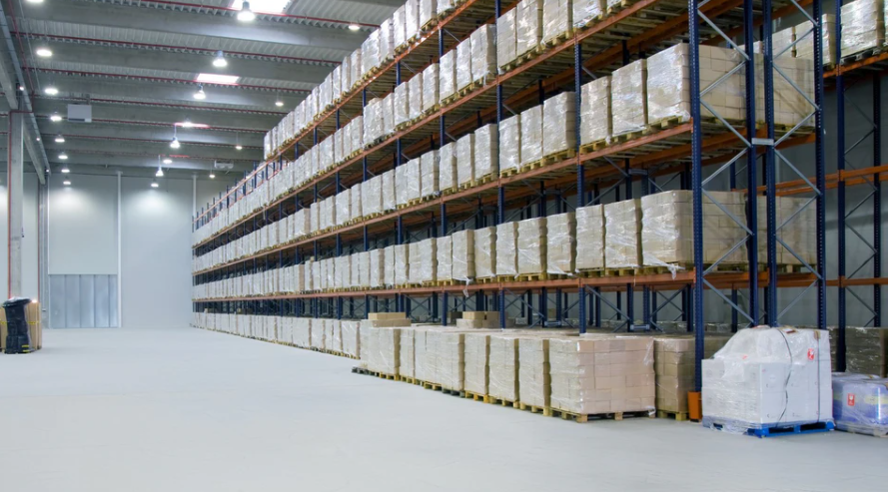


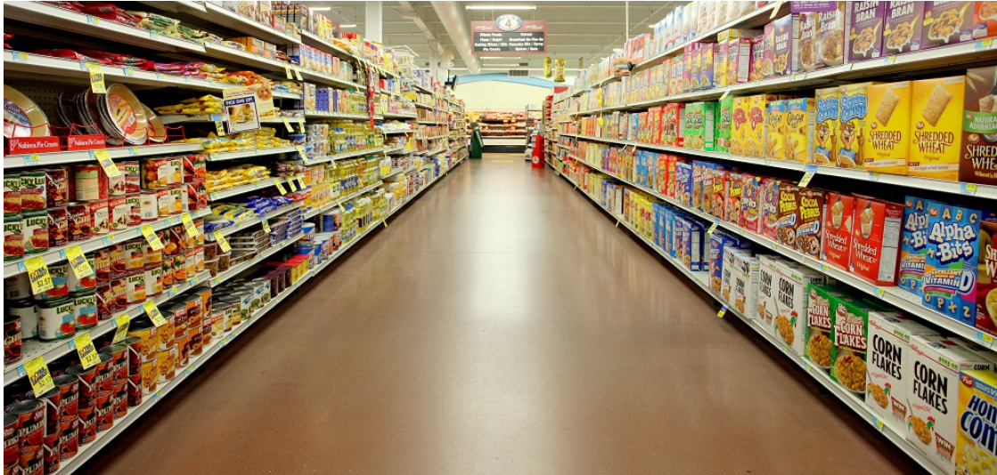
SCOPE
Grocery Department
Production Organization
Medical Department
Department Store
Cold Storage

Slide 5
HOW SYSTEM WORKS
Select a product
Check availability
Add Stock
Login/Register
Dispatch Stock
Admin
Update Intime/Outtime of material
Check product details
Manage user details

Slide 6
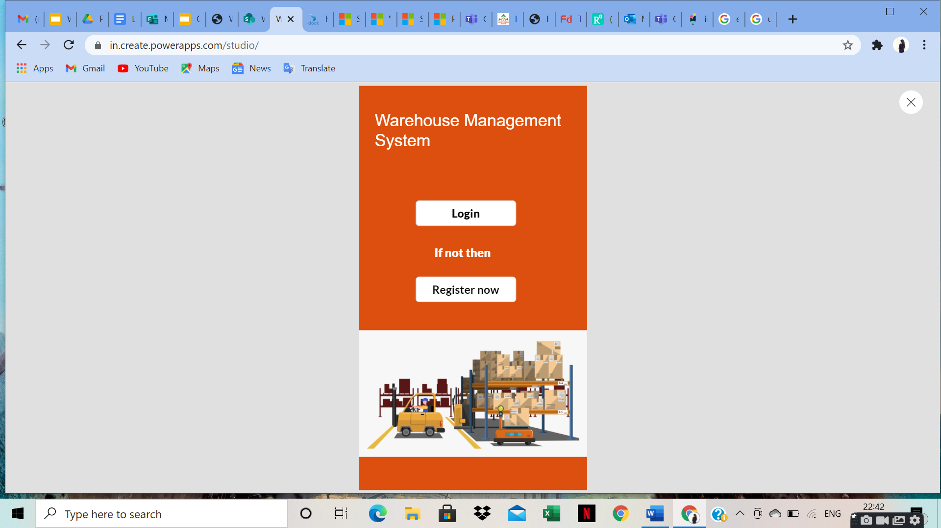
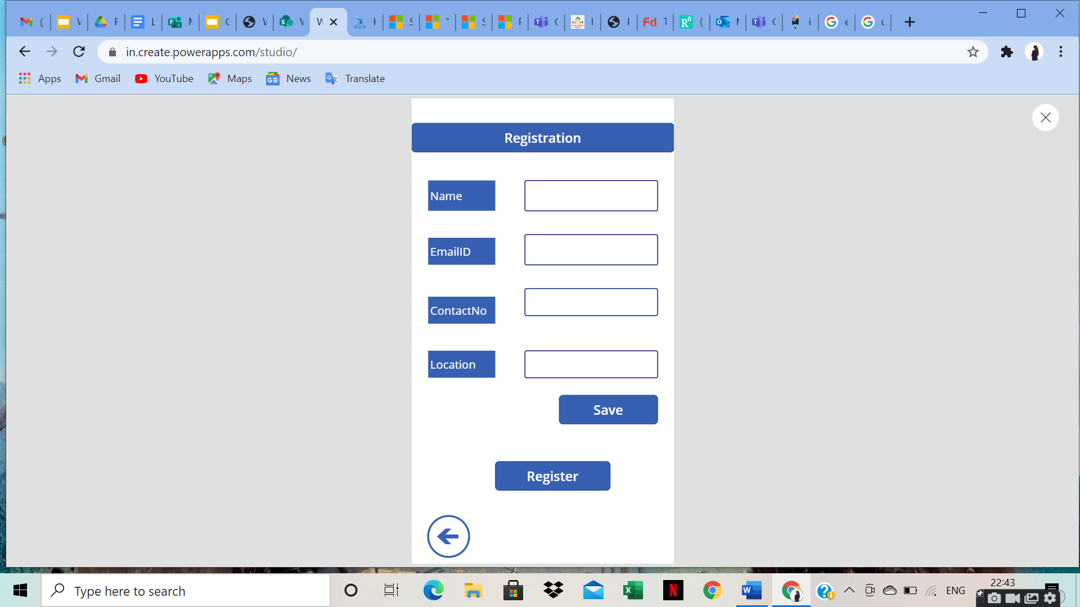
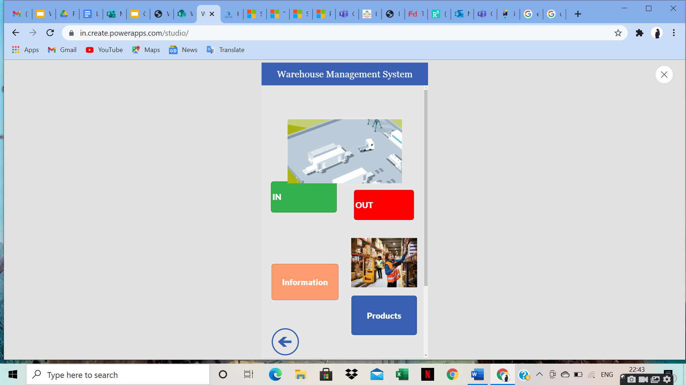
SNAPSHOTS

Slide 7
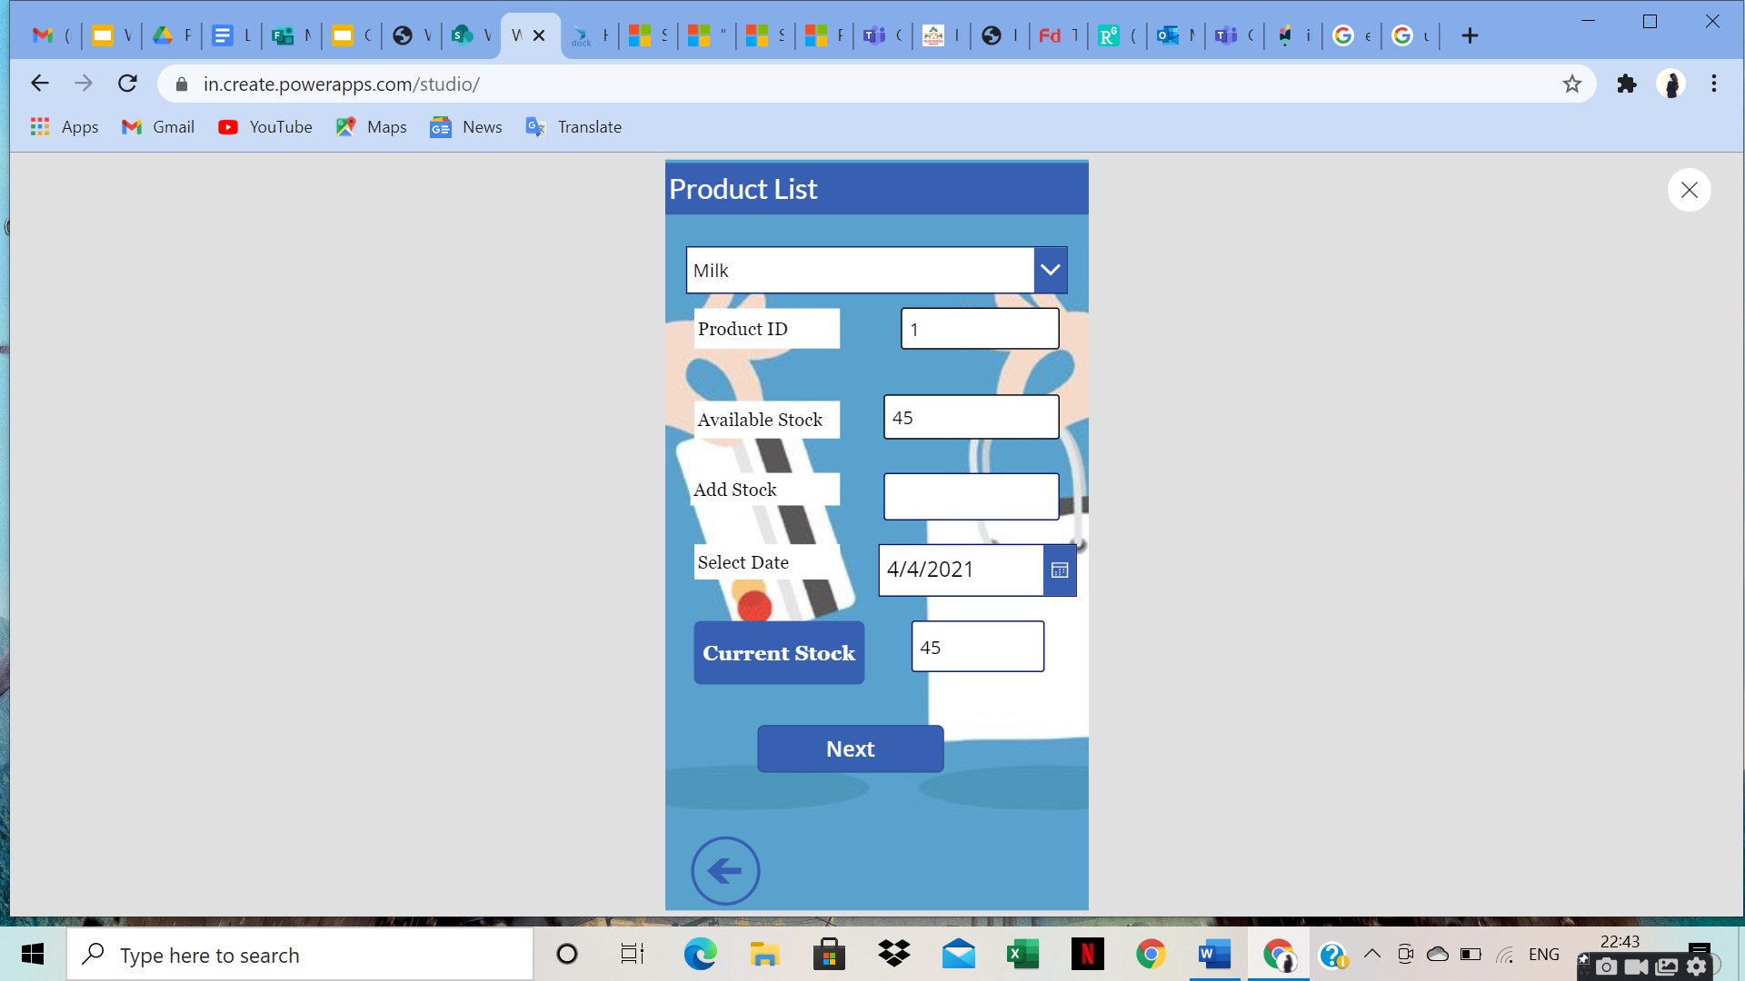
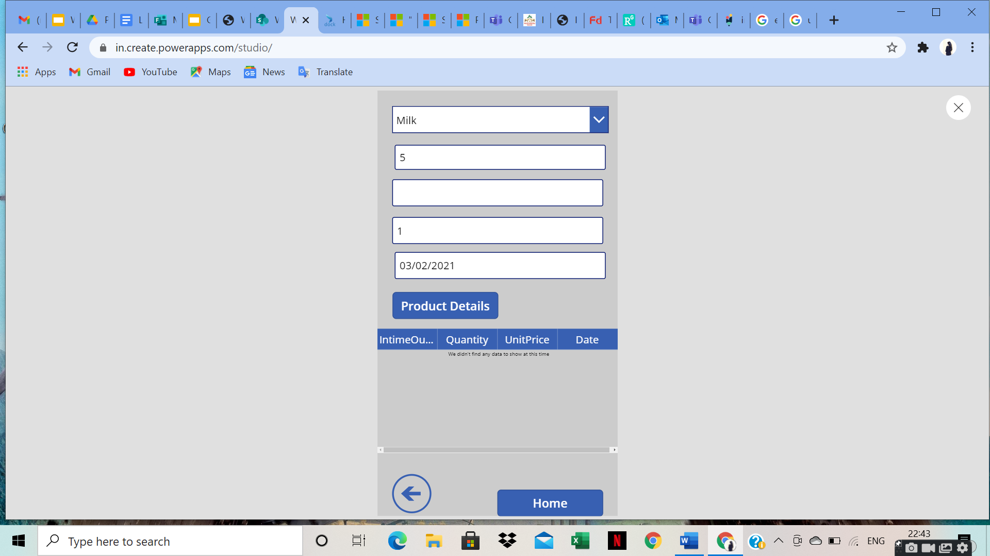
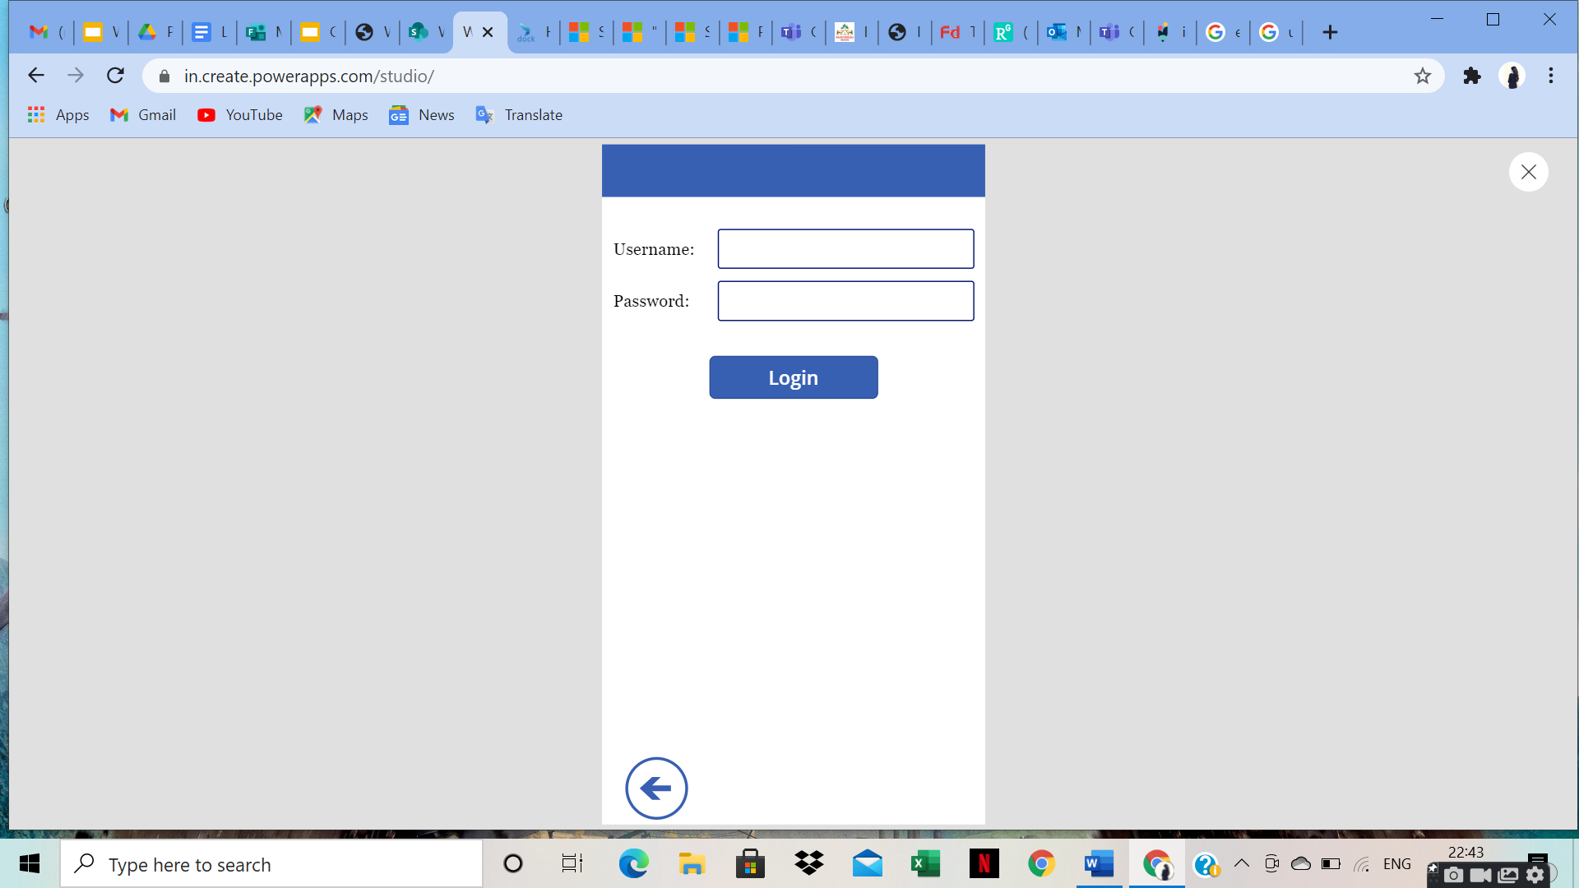


SNAPSHOTS

Slide 8
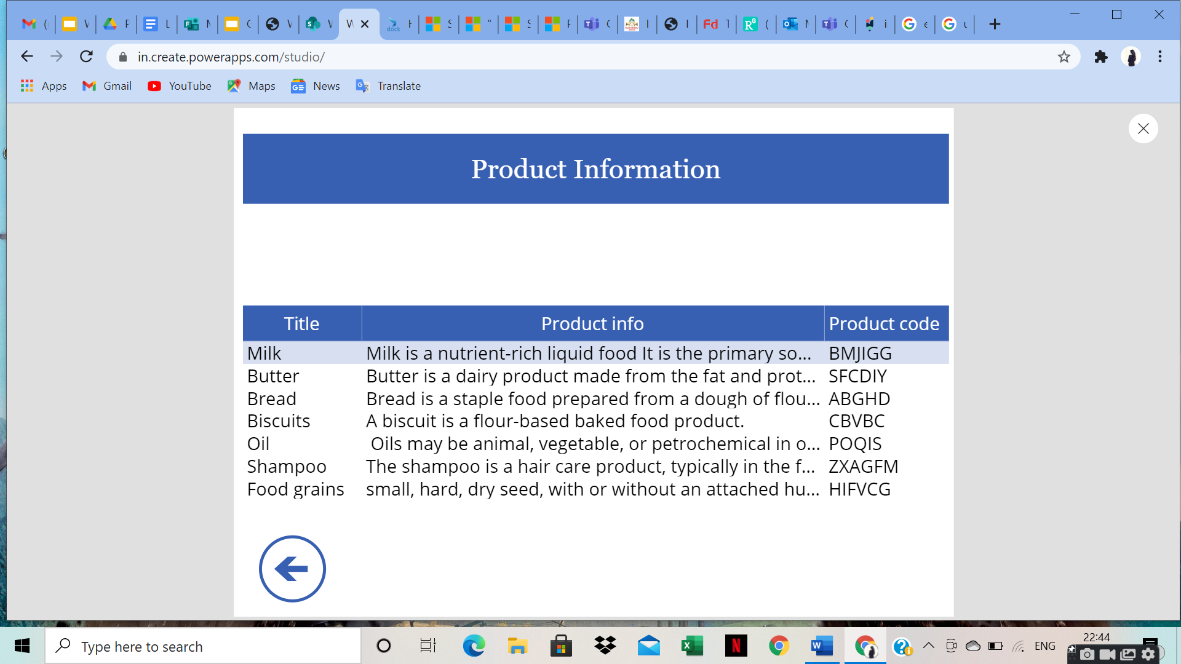
SNAPSHOTS

Slide 9


LIMITATIONS
Generate simple reports
Lack of Barcode Scanner
Single admin panel
Useful only for Small organization

Slide 10

FUTURE ENHANCEMENT
Online payment system
System flexible in any type
Lost and breakage
Lost and breakage

Slide 11

CONCLUSION
Accurate output
Simple user interface Mobile application
Overall inventory management

Slide 12

THANK YOU!

